Slide 1
PnP Community Call – August 2015
aka.ms/OfficeDevPnP
aka.ms/OfficeDevPnPYammer
aka.ms/OfficeDevPnPGuidance
aka.ms/OfficeDevPnPVideos
PnP Core Team

Slide 2

Agenda
Demos, demos, demos
Monthly highlights
Contributions and other topics
Roadmap and next steps

Slide 3

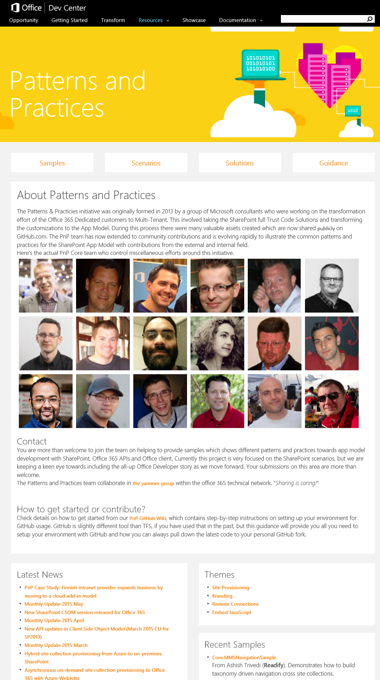
Developer
Patterns & Practices
aka.ms/OfficeDevPnP
aka.ms/OfficeDevPnPYammer
aka.ms/OfficeDevPnPMSDN
aka.ms/OfficeDevPnPVideos
aka.ms/OfficeDevPnPTraining

Slide 4
Statistics– Key numbers (previous month)
Forked 836 times (640, 528, 444, 360, 282, 227, 190, 135)
800 merged/closed pull requests (679, 593, 479, 384, 329, 280, 236, 189)
169 closed issues (145, 131, 122, 101, 73, 67, 58, 43)
More than ~3800 (4532, 4100, 4100, 3776, 2566, 3050, 2160) unique visitors during last 2 weeks
Nuget package 7977 downloads (6698, 6004, 5440, 4711, 4450, 4030, 3800)
Yammer group has 3098 members (2648, 2437, 2251, 2013, 1739, 1525, 1419, 757)
aka.ms/OfficeDevPnPYammer
Facebook page has 235 likes (199, 194, 175, 135, 121)
https://www.facebook.com/OfficeDevPnP

Slide 5
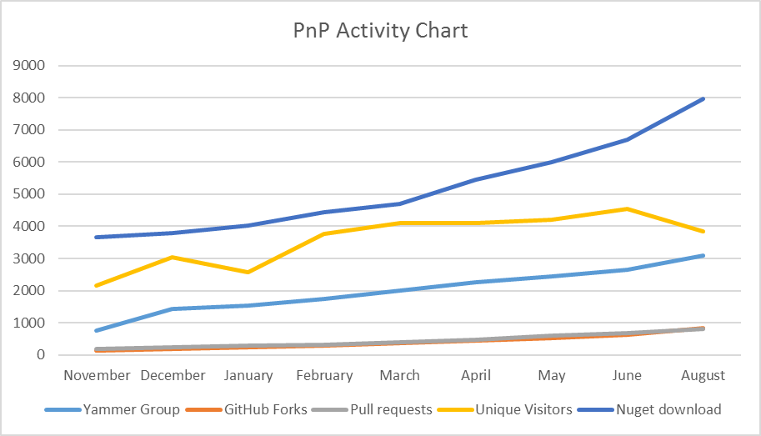
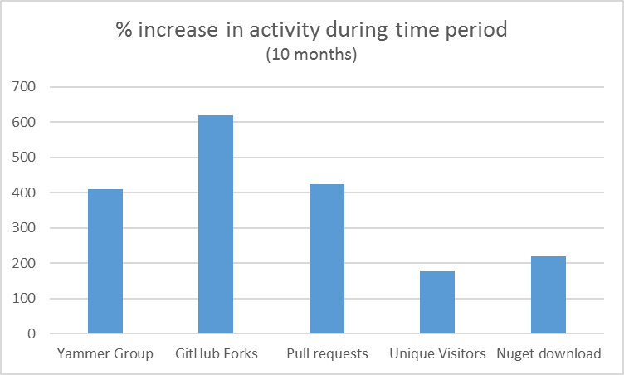

Slide 6
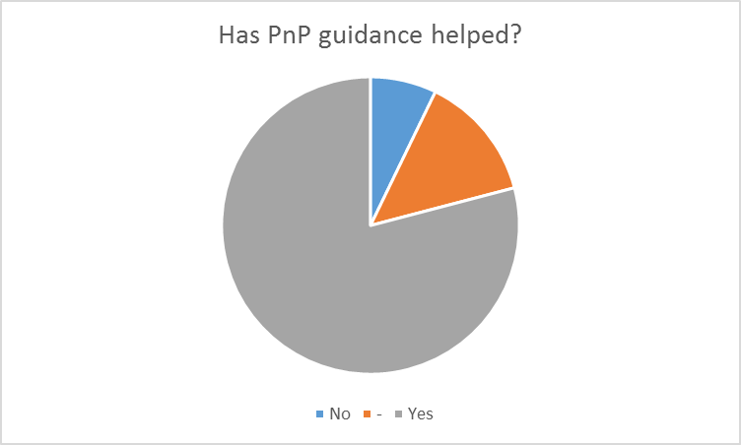
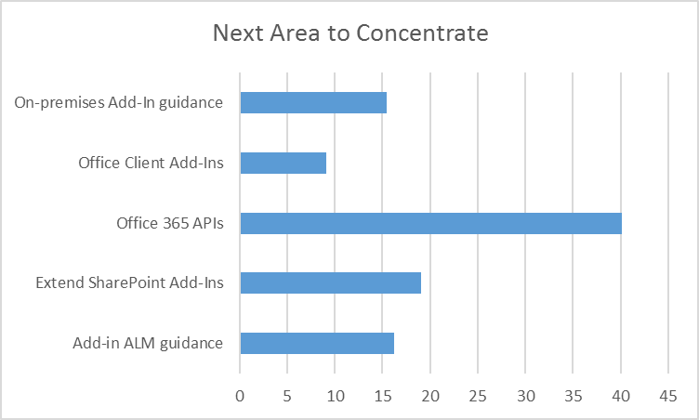
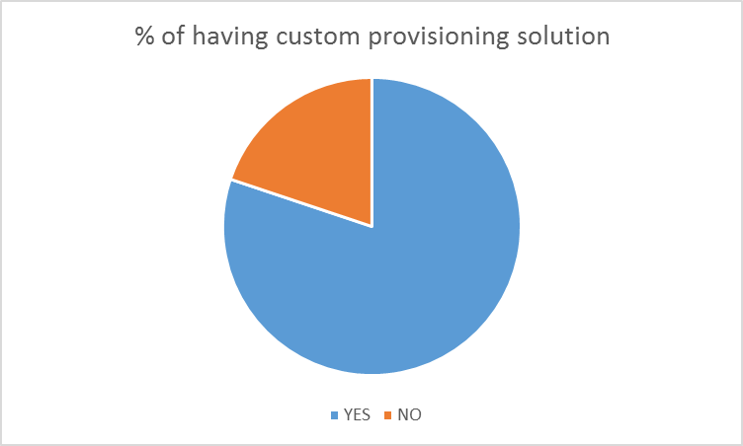
PnP Usage Survey – High level results

Slide 7
PnP Usage Survey - Comments
“You guys are simply awesome!”
“One of the greatest things done to devs. Thank you and keep up the good work.”
“Fantastic work, it's a great set of building blocks”
“customer scenario focus instead of developer focus”
“Office PnP is by far the most collaborative and open forum I have ever seen in my 15 years working with Microsoft.”

Slide 8
PnP GitHub Repository Split plan In progress
PnP – Main
PnP-Guidance – Articles and presentations
PnP-Provisioning-Schema
PnP-Sites-Core – New
PnP-PowerShell – New
PnP-OfficeAddIns – New
PnP-Office365-API – New
PnP-Partner-Pack – Future
What does it mean?
Please move using the Dev branches of the new repositories when submitting pull requests
As an example – any update on the Core component should be now submitted towards the Dev branch under PnP-Sites-Core repository

Slide 9
August Release - new samples
New component Core.JQuery contains a set of jQuery extensions to enable extending SharePoint functionality to provider hosted apps using the familiar jQuery syntax.
New solution Core.ConnectedAngularAppsV2 shows AngularJS and SignalR way to perform connected web parts with enhanced implementation.
New sample BusinessApps.RemoteCalendarAccess shows a method of sharing a SharePoint site calendar with any calendar client via iCalendar. The sample reads events from a SharePoint calendar and converts those events into a standard iCalendar format utilizing SharePoint CSOM, Azure Active Directory Graph Client Library, SQL Azure via Entity Framework, and Azure Web Apps.
New sample Core.EmbedJavaScript.HeaderFooter provides a provision page to include a custom Header and Footer. The Header and Footer sample includes custom Global Breadcrumbs (SharePoint or JSON Data) and custom Global Ribbons that are acessible in all sites and subsites associated to Site Collection.
New sample AzureAD.RedisCacheUserProfile shows how to use windows Azure Active directory to get user profile information and how to use Azure REDIS Cache to make performant Add-Ins.
New sample AzureAD.WebAPI.SPOnline shows how to call a Web API secured by Azure AD and the API calls SharePoint Online on behalf the logged in user. This scenario is useful for situations where you need a protected API Proxy to interact with SharePoint Online using User's credentials.
Multiple updated samples based on community contributions around bugs and improvements.

Slide 10
August Release – Core and engine updates
Core
provisioning engine updates
Additional code quality improvements
Azure AD Authentication support
Build and test automation improvements
Both PnP Core Nuget packages (cloud and on-premises) have been also updated accordingly.
PnP Provisioning Engine
Delta handling support for template provisioning where possible
For example for fields, content types, lists, views, custom actions
Overall quality and performance improvements
Significant improvements on the on-premises support
Support to provision URL Field into the DataRow of a ListInstance
JSLink provisioning support for views

Slide 11
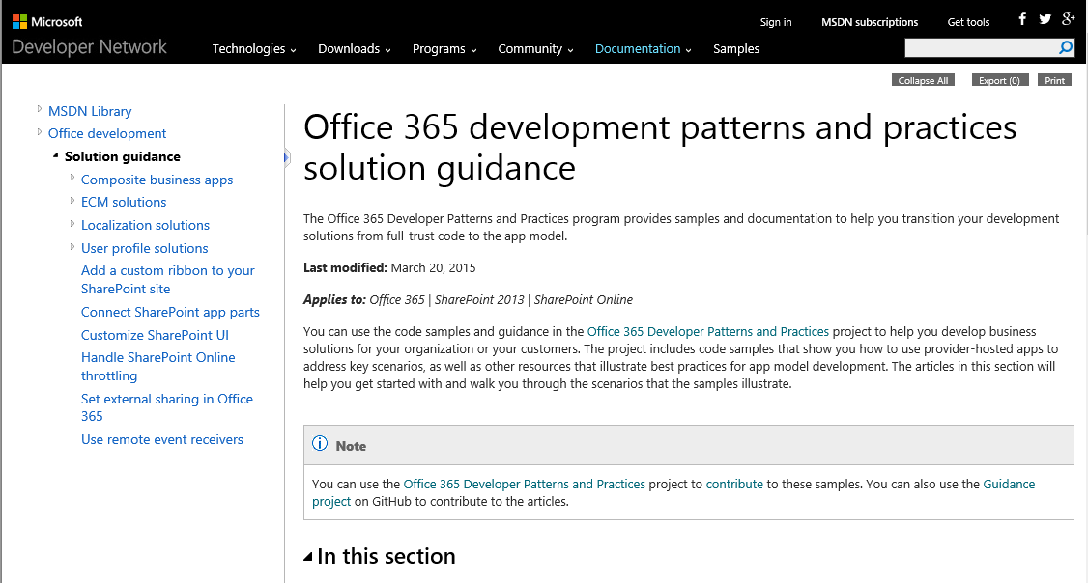
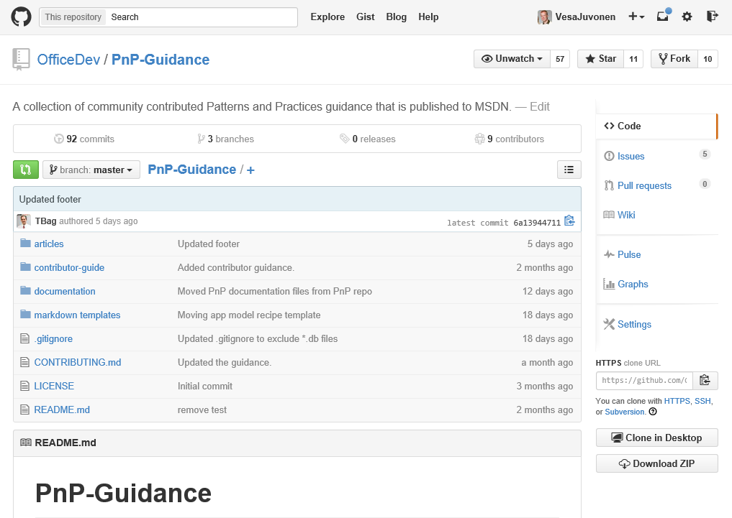
August release - guidance updates
SharePoint Add-in Recipe - Custom Actions
SharePoint Add-in Recipe - Custom field type
SharePoint Add-in Recipe - Delegate controls
SharePoint Add-in Recipe - Document ID Provider
SharePoint Add-in Recipe - Elevated privileges
SharePoint Add-in Recipe - Event Receivers & List Event Receivers
SharePoint Add-in Recipe - Feature Stapling
SharePoint Add-in Recipe - Information Management Policy
SharePoint Add-in Recipe - List definition / list template
SharePoint Add-in Recipe - List instance
SharePoint Add-in Recipe - Localization
SharePoint Add-in Recipe - Master Pages
SharePoint Add-in Recipe - MMS manipulation
SharePoint Add-in Recipe - Modules
SharePoint Add-in Recipe - OneDrive for Business customization
SharePoint Add-in Recipe - Performance Considerations
SharePoint Add-in Recipe - Remote Timer Jobs
SharePoint Add-in Recipe - Search API Usage
SharePoint Add-in Recipe - Site columns and content types
SharePoint Add-in Recipe - User Profile Manipulation
SharePoint Add-in Recipe - Variations
SharePoint Add-in Recipe - User controls and Web controls
SharePoint Add-in Recipe - Web Part
SharePoint Add-in Recipe - Workflows, Actions (Activities), Events, and Forms
SharePoint Add-in Recipe - Yammer Integration
Guidance – http://aka.ms/OfficeDevPnPGuidance
MSDN– http://aka.ms/OfficeDevPnPMSDN

Slide 12
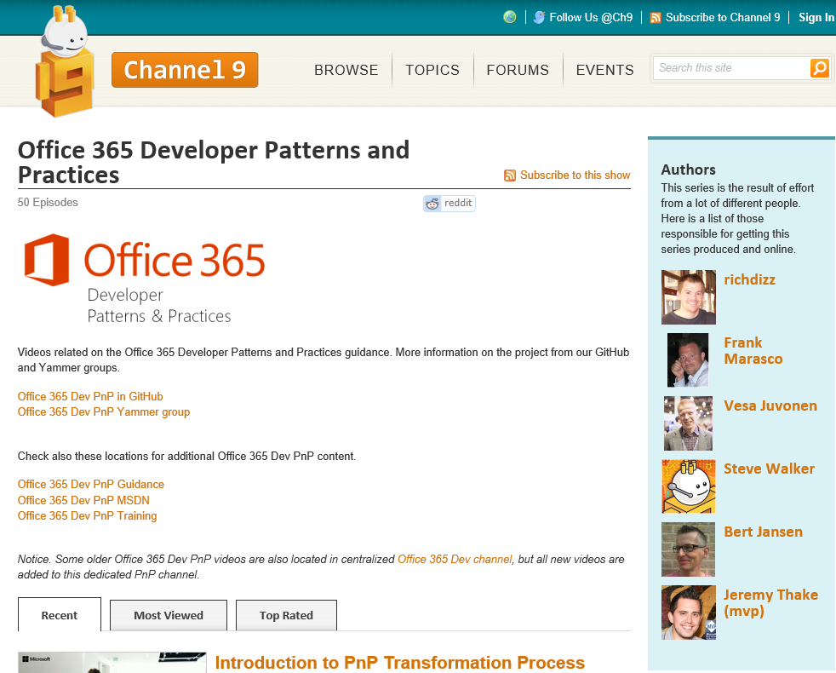
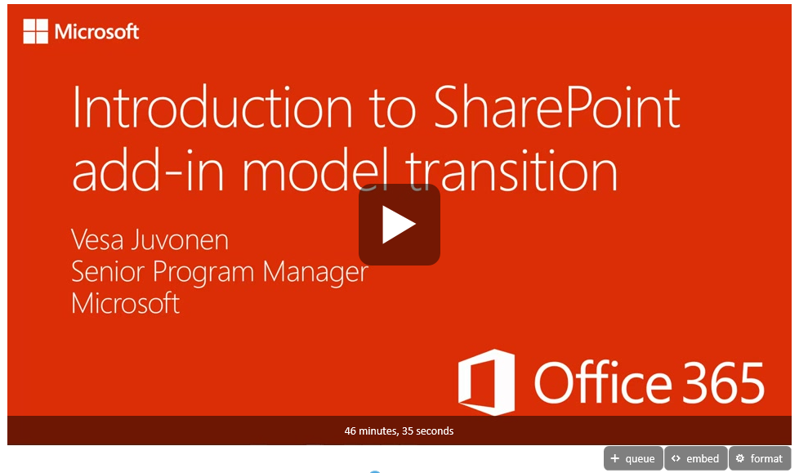
August release – New Videos – a lot
Introduction to PnP Transformation Process
PnP Add-In Transformation Training module 1: Introduction
PnP Add-In Transformation Training Module 2: Managing site settings using add-in model
PnP Add-In Transformation Training module 3: Branding with add-in model
PnP Add-In Transformation Training module 5: Using Remote Event Receivers and Remote Timer Jobs
PnP Add-In Transformation Training module 6: Site provisioning with add-in model
PnP Add-In Transformation Training module 8: Using Enterprise Content Management Capabilities with add-in model
PnP Add-In Transformation Training Module 9: Using Search Capabilities with add-in model
PnP Add-in Transformation Training Module 10: Transformation guidance from farm solutions to add-in model
Demo - How to customize a Search Center with SharePoint add-ins
Demo - How to build SharePoint add-ins that leverage search
Demo - How to perform personalized search queries with CSOM
Demo - How to Export and Import Search Configurations with CSOM
Demo - Asynchronous remote provisioning solution for self service site collection creation
Demo - Using remote provisioning pattern for sub site creation
Demo - Using Office 365 themes to provide branding elements in Office 365
Demo - Applying and using custom SharePoint themes with add-in model
Demo - Using alternate CSS for providing custom branding in SharePoint site
Demo - How to use Azure Service Bus to debug your remote event receivers
Demo - How to use remote event receivers for your SharePoint add-ins
Demo - You can still have timer jobs using the add-in model
Demo - How to use client side caching to optimize the performance of your add-ins
Demo - How to update your SharePoint pages via the embedding of JavaScript
Demo - How to modify wiki pages using the add-in model
Videos – http://aka.ms/OfficeDevPnPVideos

Slide 13

Thank you for your assistance! – 1/2
André Lage (Processlynx AG)
Ben McClaren
Erwin van Hunen (Knowit AB) - @erwinvanhunen
Etienne Bailly | MCT - @etienne_bailly
Danny Jessee - @dannyjessee
GeiloStylo - GitHub alias
Ivan Vagunin (Knowit AB) - @ivagunin
Jonathan Huss (Microsoft) - @JonathanHuss
Ken Domen (Nike) - @kendomen
Lester Sconyers - @lestersconyers
Louis-Charles Gagnon (LS2 Investments Inc.)
Luis Valencia - @levalencia
Mårten af Sandeberg (Knowit AB)
Matthew Chestnut
Michael Schau (WorkPoint A/S)
Nige Price - @Nigel_Price
Nanddeep Nachan - @NanddeepNachan

Slide 14
Thank you for your assistance! – 2/2
Paolo Pialorsi (PiaSys.com) - @PaoloPia
Radi Atanassov (OneBit Software) - @RadiAtanassov
Robin Engström (Knowit AB) - @robinestrm
Rodrigo Romano - rodrigoromano.net
Roman Rozinov - @romanrozinov
Stijn Neirinckx
Tobias Zimmergren (Tozit AB) - @zimmergren
Todd Baginski (Canviz LLC) @toddbaginski
Torsten Schuster
Vardhaman Deshpande - @vrdmn
Vincent Wesker - @VWesker
ZeBobo5 - GitHub alias
MS Core Team members – Antons Mislevics, Bert Jansen, Brian Michely, Dan Budimir, Frank Chen, Frank Marasco, Jeremy Thake, Kiki Shuxteau, Laura Graham, Reeza Ali, Ron Tielke, Sami Nieminen, Steve Walker, Vesa Juvonen

Slide 15

Roadmap – September release plan
Provisioning engine
Add new capabilities like language settings, regional settings, auditing etc.
Documentation
Core component v1.x
Continue evolving the Core component, which is however pretty stable
Samples and solutions
Governance apps from MS IT
Contributions from the field
Transformation IP
PnP Partner Pack
Articles and guidance
Additional MSDN updates
On-premises App model setup
ALM guidance for add-in/app model
Transformation recipes finalization as v1.0

Slide 16

Demos, demos, demos!
Erwin van Hunen – Provisioning engine with delta support ~20 min
Luis Esteban Valenci - Using Azure for performance improvements with caching ~10 min

Slide 17
Transform your code Providing add-in model patterns for SharePoint, Office and Office 365 APIs. Ready to use samples to get started.
130+ Visual Studio projects Common scenarios
Branding
Site provisioning
Remote event receivers
Large file support
Taxonomy driven navigation
And much more…
Contribute
This is open source project and open for contributions
Developer
Patterns & Practices
aka.ms/OfficeDevPnP

Slide 18

Questions?

Slide 19


© 2015 Microsoft Corporation. All rights reserved. Microsoft, Windows, and other product names are or may be registered trademarks and/or trademarks in the U.S. and/or other countries.
The information herein is for informational purposes only and represents the current view of Microsoft Corporation as of the date of this presentation. Because Microsoft must respond to changing market conditions, it should not be interpreted to be a commitment on the part of Microsoft, and Microsoft cannot guarantee the accuracy of any information provided after the date of this presentation. MICROSOFT MAKES NO WARRANTIES, EXPRESS, IMPLIED OR STATUTORY, AS TO THE INFORMATION IN THIS PRESENTATION.

